Slide 1
Disclaimer
RC-17, Sci-Fi
This presentation contains heavy use of mathematical and biological words.
Any question/confusion coming to your mind is outside the boundaries of this session. There is a penalty (that will be paid by OP) for every question asked and penalty depends upon the difficulty level of question and whether presenter is able to answer or not.

Slide 2
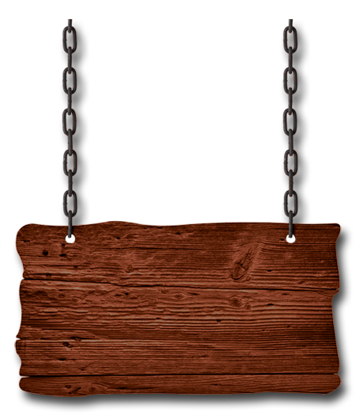
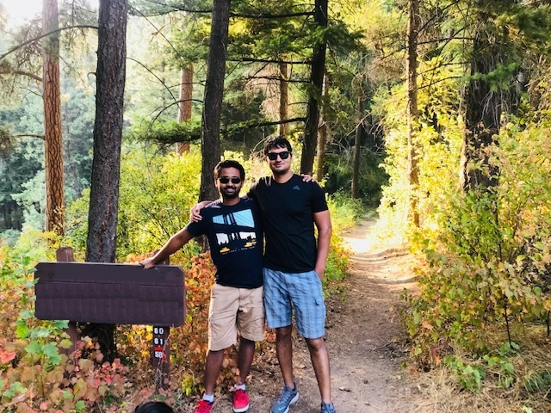
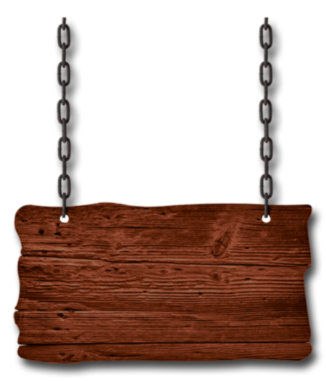
AGENDA:
Recap from previous session
Supervised vs Unsupervised ML
Deep Learning (what & why)
DL in action
Neural Networks
ANN
CNN
DL Framework
Demo
Welcome To
Deep Learning

Slide 3

Previous Session… Beginning

Slide 4
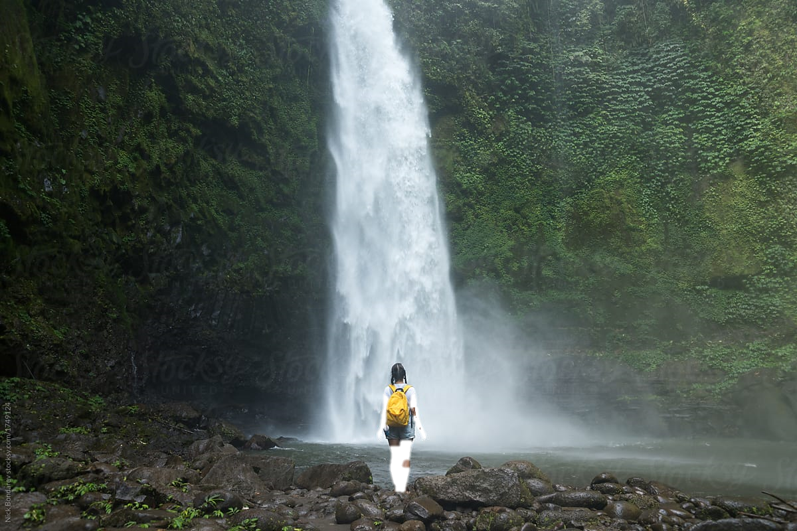
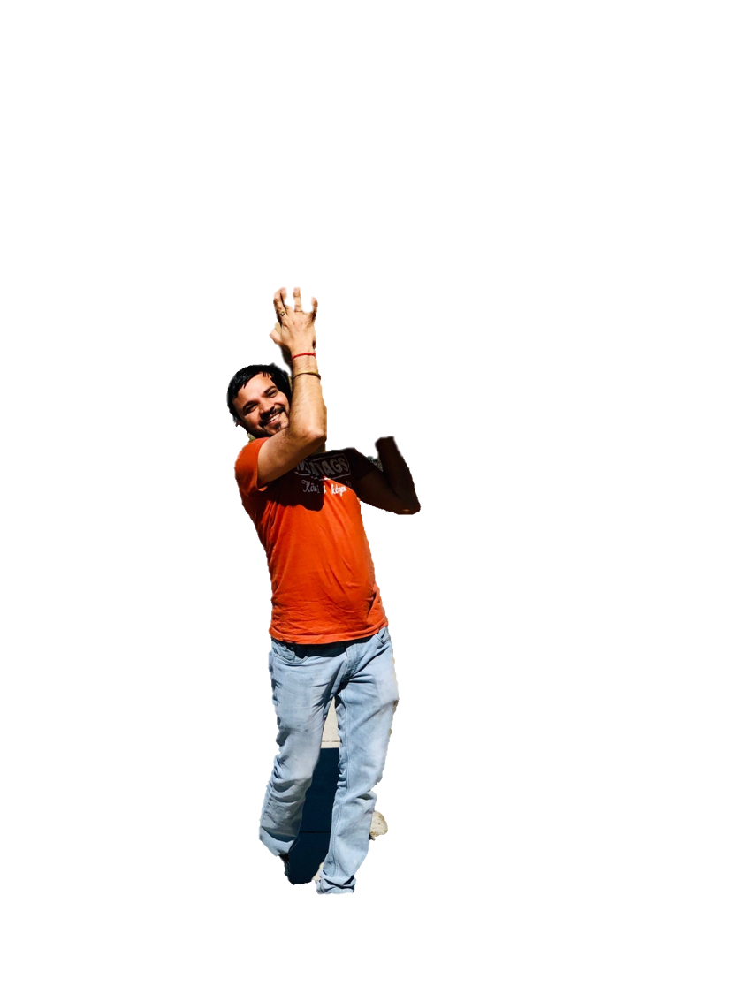
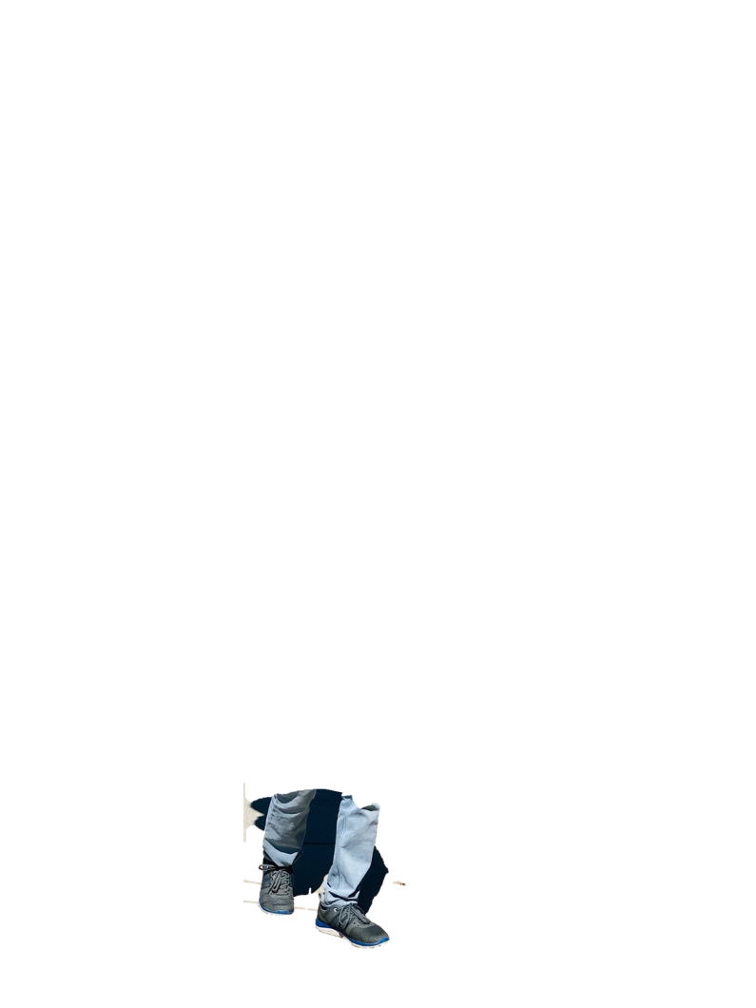
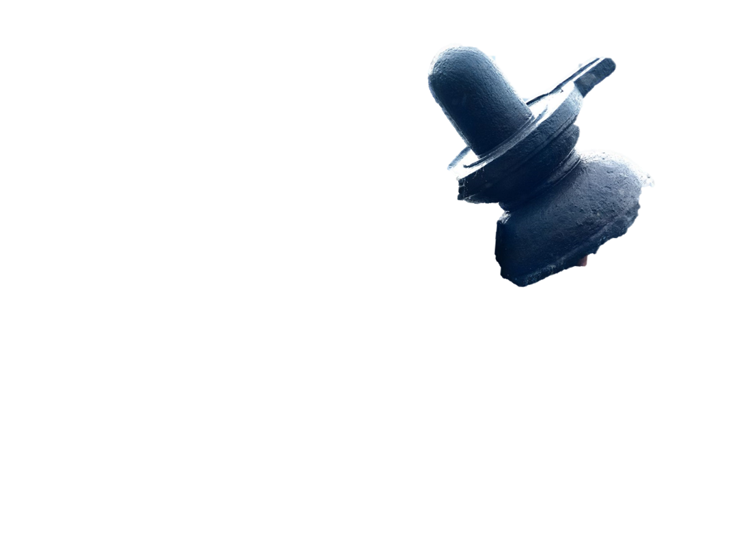
Now time for… Conclusion

Slide 5
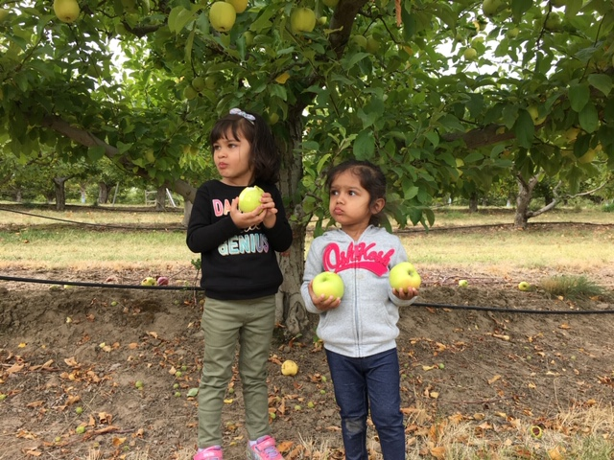
Don’t Expect
I never thought about it, lets name it Gravity
How come apples are falling down?

Slide 6
Then what this session tells!
Youtube
Pluralsight
Blogs
This Session

Slide 7
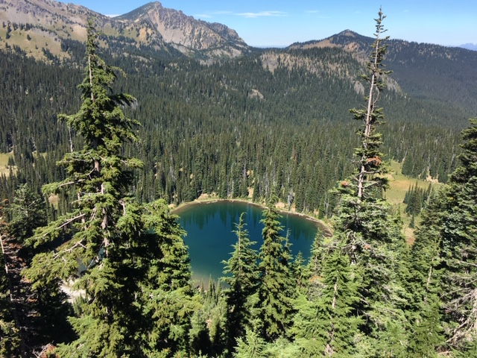
Expectation
High level understanding of Deep Learning and Neural Network
High level understanding of Deep Learning & Neural Network

Slide 8
Session Level:
Beginner
Intermediate
Advance

Slide 9

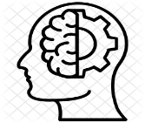

AI vs. ML vs. DL
1950
Artificial Intelligence: can be loosely interpreted to mean incorporating human intelligence to machines
Machine Learning: Subset of AI techniques which use statistical methods to enable machines to improve with experience
Deep Learning: is one of many approaches to machine learning. Geoffrey E. Hinton is known as Father DL
1990
Amazon recommendations
Email Spam
Netflix
2010
Gmail smart reply
Facebook photo tagging
AlphaGo
Notes:
32 years ago written First Deep Learning Algorithm in 1986, which is still a basis of todays algorithm by Geoffrey E. Hinton

Slide 10


Supervised vs. Unsupervised
Supervised
Unsupervised
All data is labeled and the algorithms learn to predict the output from the input data.
All data is unlabeled and the algorithms learn to inherent structure from the input data.

Slide 11
Lets Take an Example

Slide 12
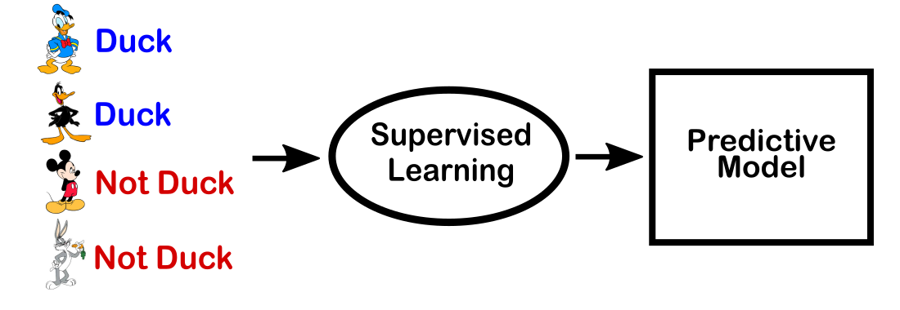
Supervised Learning

Slide 13
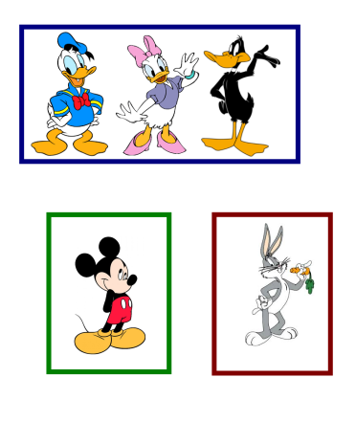
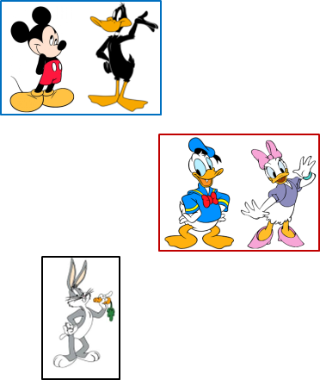
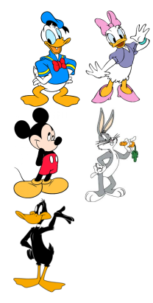
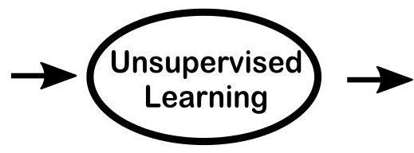
Unsupervised Learning
×
?

Slide 14
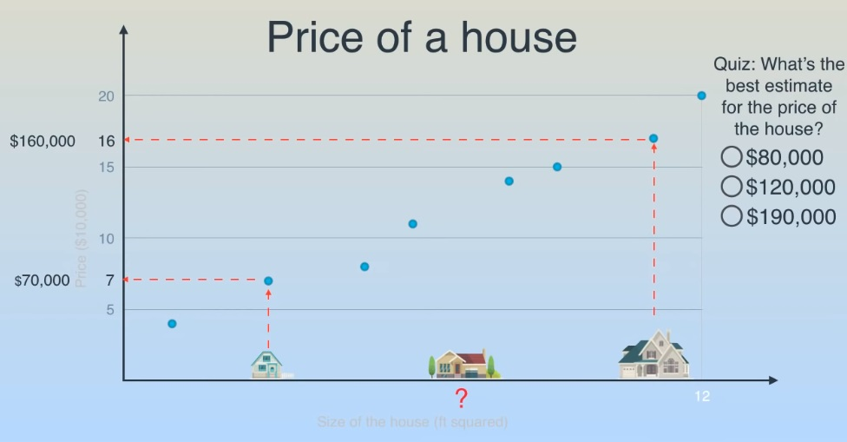
Question

Slide 15
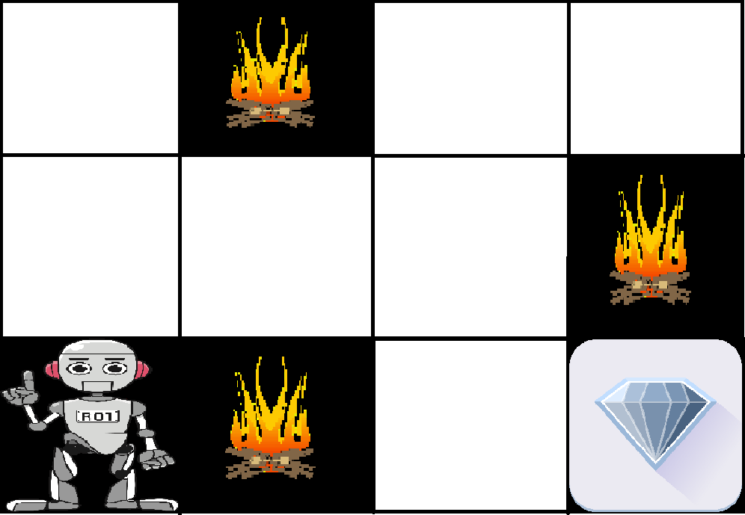
Are there any other type of ML?
Semi-Supervised: Some data is labeled but most of it is unlabeled and a mixture of supervised and unsupervised techniques can be used.
Reinforcement Learning: reinforcement learning trains an algorithm with a reward system, providing feedback when an artificial intelligence agent performs the best action in a particular situation.

Slide 16
What is Alexa?
Supervised
Or, Unsupervised
Or, Something Else?
Alexa uses a suite of learning techniques: supervised, semi-supervised, and unsupervised learning. While supervised learning is still most powerful, it does not scale since we cannot generate manual labels at the pace required to continually improve Alexa for our customers.
Notes:
Since Alexa’s brain is mostly in the cloud, she gets smarter with every interaction. Alexa uses a suite of learning techniques: supervised, semi-supervised, and unsupervised learning. While supervised learning is still most powerful, it does not scale since we cannot generate manual labels at the pace required to continually improve Alexa for our customers. Therefore, our scientists and engineers are continually applying and inventing new learning techniques to reduce reliance on manual labels for training our statistical models. For instance, active learning as a class of semi-supervised learning techniques, where the system itself posits which part of the interactions it needs input from a human expert, is pervasive across our technologies. Unsupervised learning without any labeled responses is also being applied to make Alexa smarter, especially for speech recognition. Finally, we also use transfer learning, allowing Alexa to learn from one skill to another or even one language to another.

Slide 17
What is Deep Learning ?
It is a form of Artificial Intelligence that uses type of Machine Learning called an Artificial Neural Network with Multiple Hidden Layers that learns Hierarchical Representations of underlying data in order to make Predictions with Data

Slide 18

It’s right time…

Slide 19
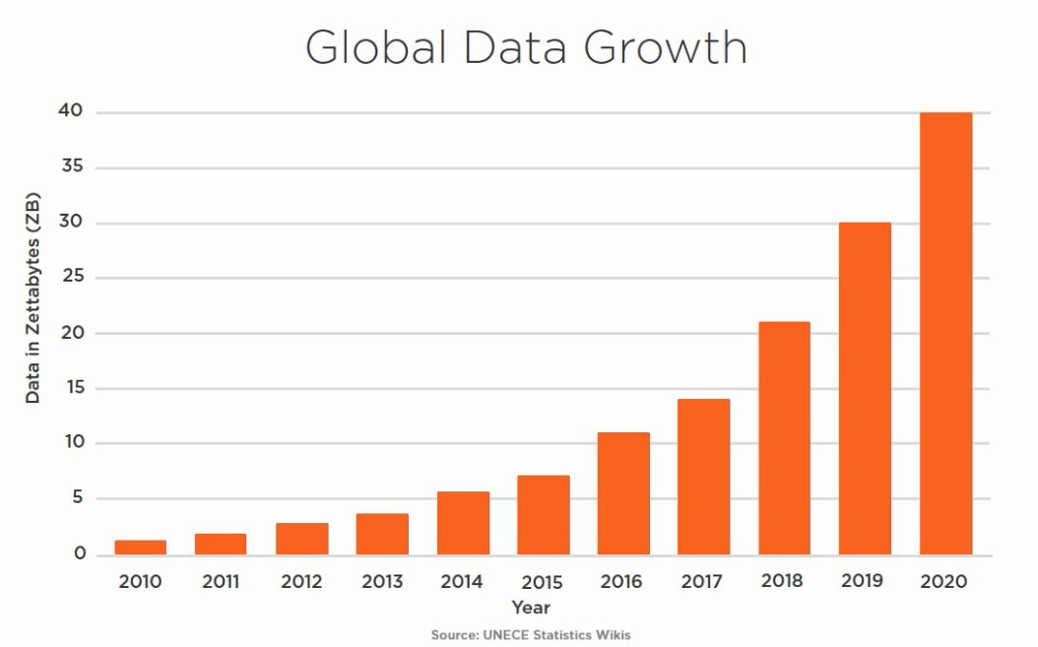
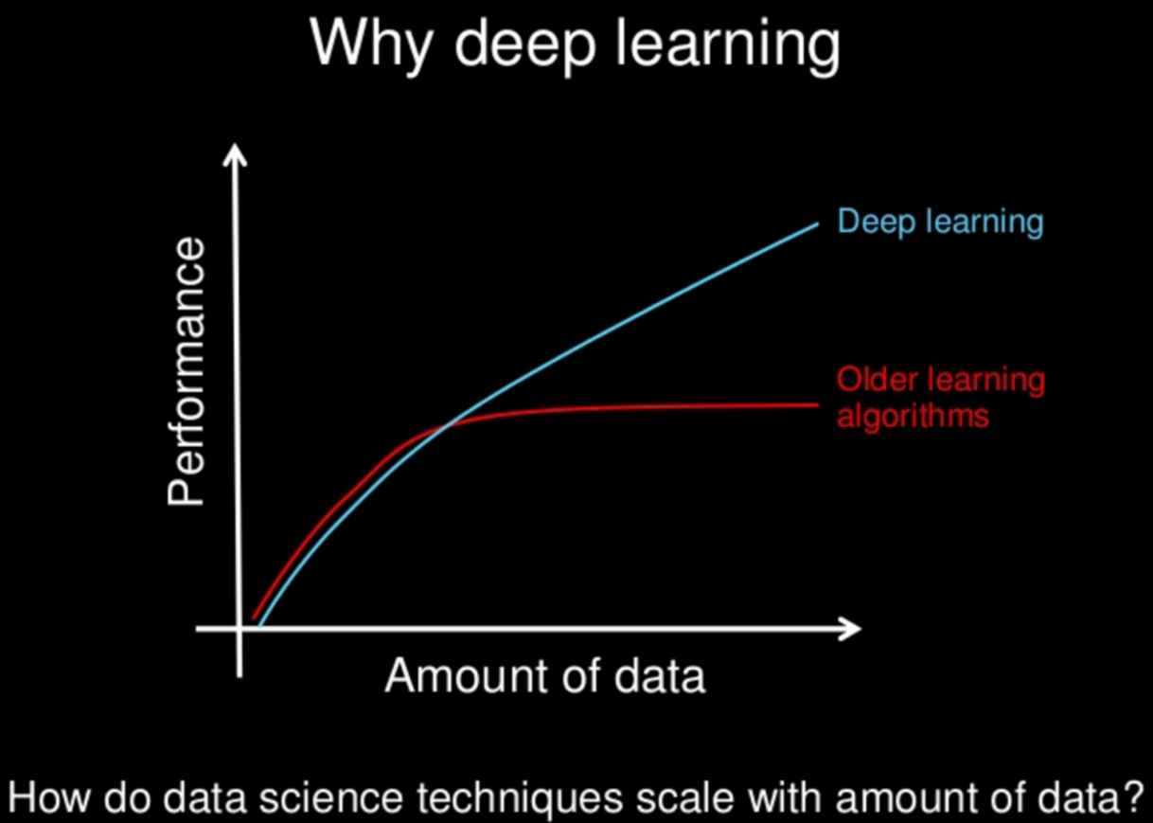
Why Deep Learning?
Why Deep Learning NOW?
Deep learning requires large amounts of labeled data.
Deep learning requires substantial computing power.
Notes:
A single 800-by-1000-pixel image in RGB color has 2,400,000 features – far too many for traditional machine learning algorithms to handle, which try and take in all the information at once.
For instance, ImageNet, the common benchmark for training deep learning models for comprehensive image recognition, has access to over 14 million images.
While deep learning was first theorized in the 1980s, there are two main reasons it has only recently become useful:
Deep learning requires large amounts of labeled data. For example, driverless car development requires millions of images and thousands of hours of video.
Deep learning requires substantial computing power. High-performance GPUs have a parallel architecture that is efficient for deep learning. When combined with clusters or cloud computing, this enables development teams to reduce training time for a deep learning network from weeks to hours or less.

Slide 20
Question:
Deep Learning is Supervised or Unsupervised?

Slide 21
Examples of Deep Learning
Colorization of Black and White Images
Adding Sounds To Silent Movies
Automatic Machine Translation
Object Classification in Photographs
Automatic Handwriting Generation
Character Text Generation
Image Caption Generation
Automatic Game Playing

Slide 22
Deep Learning Algorithms
Convolutional Neural Network (CNN)
Recurrent Neural Network (RNN)
Recursive Neural Tensor Network (RNTN)
Deep Belief Neural Network (DBN)

Slide 23
How to Choose?
Text Processing
RNTN
RNN
Image Recognition
DBN
CNN
Object Recognition
RNTN
CNN
Speech Recognition
RNN

Slide 24
Terms
Node/Neuron
Weights
Bias
Forward Propagation
Backward Propogation
Gradient Descendent
Notes:
AlphaGo versus Lee Sedol, also known as the Google DeepMind Challenge Match, was a five-game Go match between 18-time world champion Lee Sedol and AlphaGo, a computer Go program developed by Google DeepMind, played in Seoul, South Korea between 9 and 15 March 2016. AlphaGo won all but the fourth game;^{[1]} all games were won by resignation.^{[2]} The match has been compared with the historic chess match between Deep Blue and Garry Kasparov in 1997.

Slide 25
What is Artificial Neural Network?
Neuron
Network
What is a Neuron?
How they are connected?

Slide 26
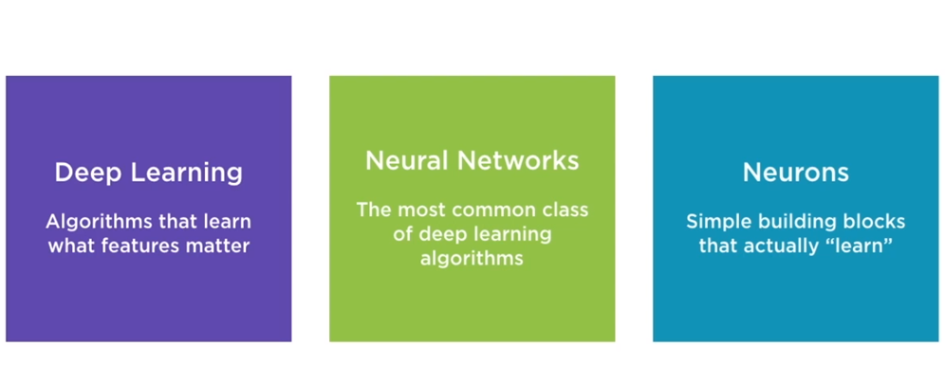
What is Neural Network?

Slide 27
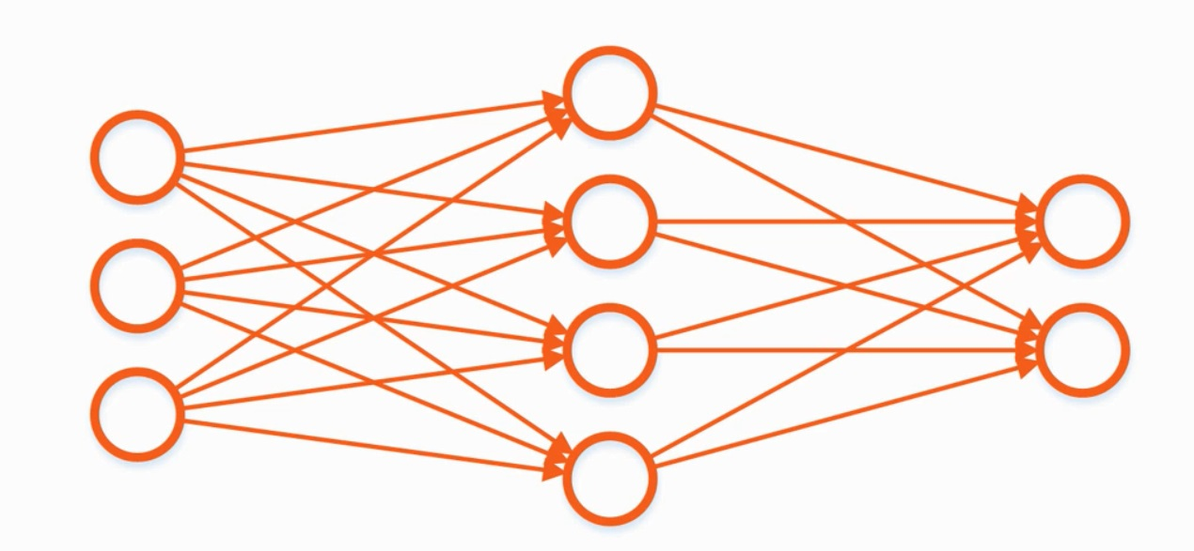
Artificial Neural Network

Slide 28
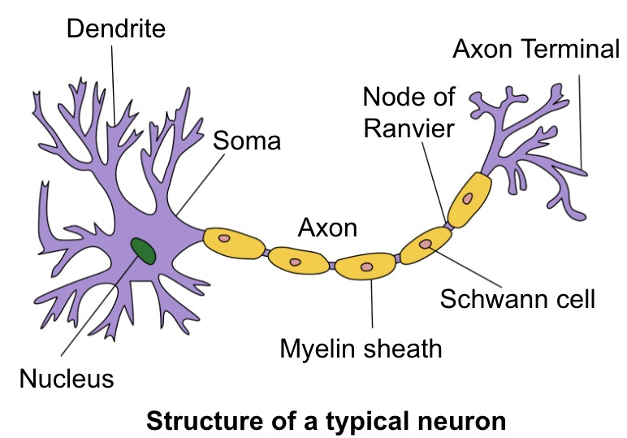

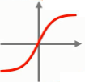
What is Neuron?
What is Artificial Neuron?
Activation Func.
x1
b
w1
This is not a biology session
∑
Y
x2
w2
w3
x3
Input
Neuron
Output

Slide 29
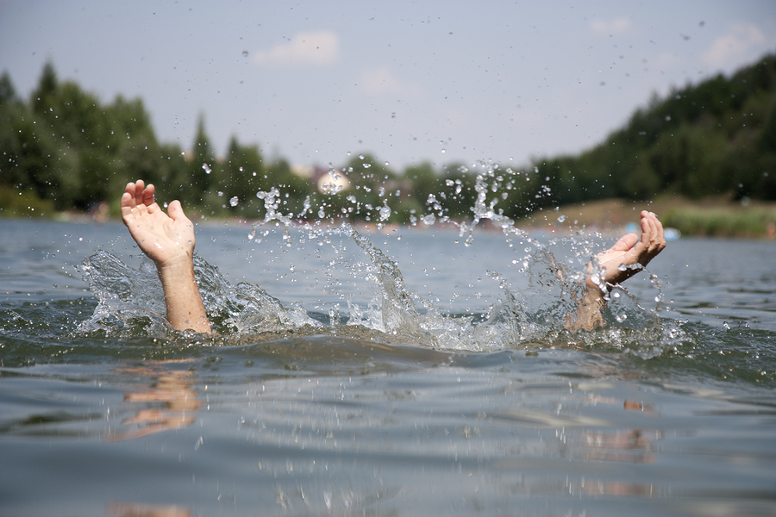
Lets go more Deeper…

Slide 30
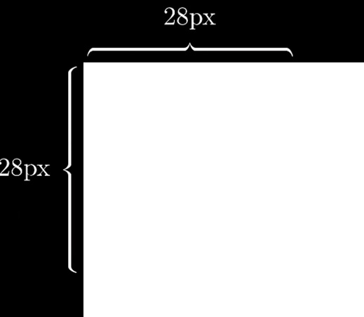
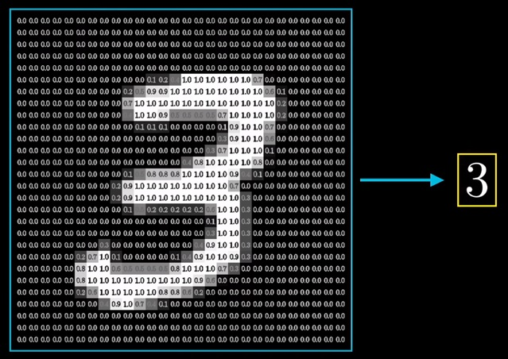
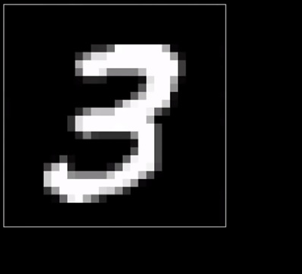
Example

Slide 31
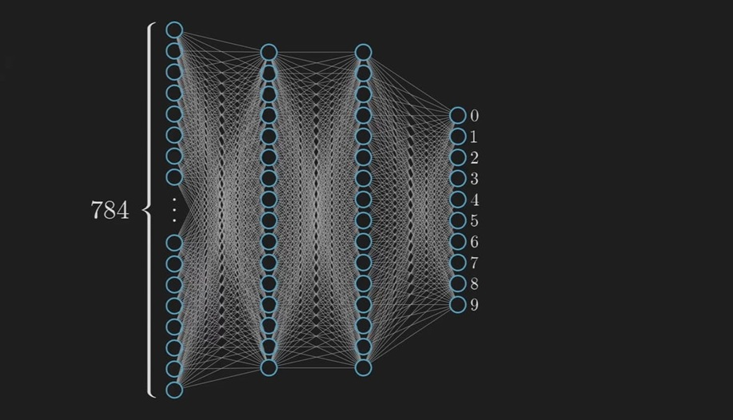
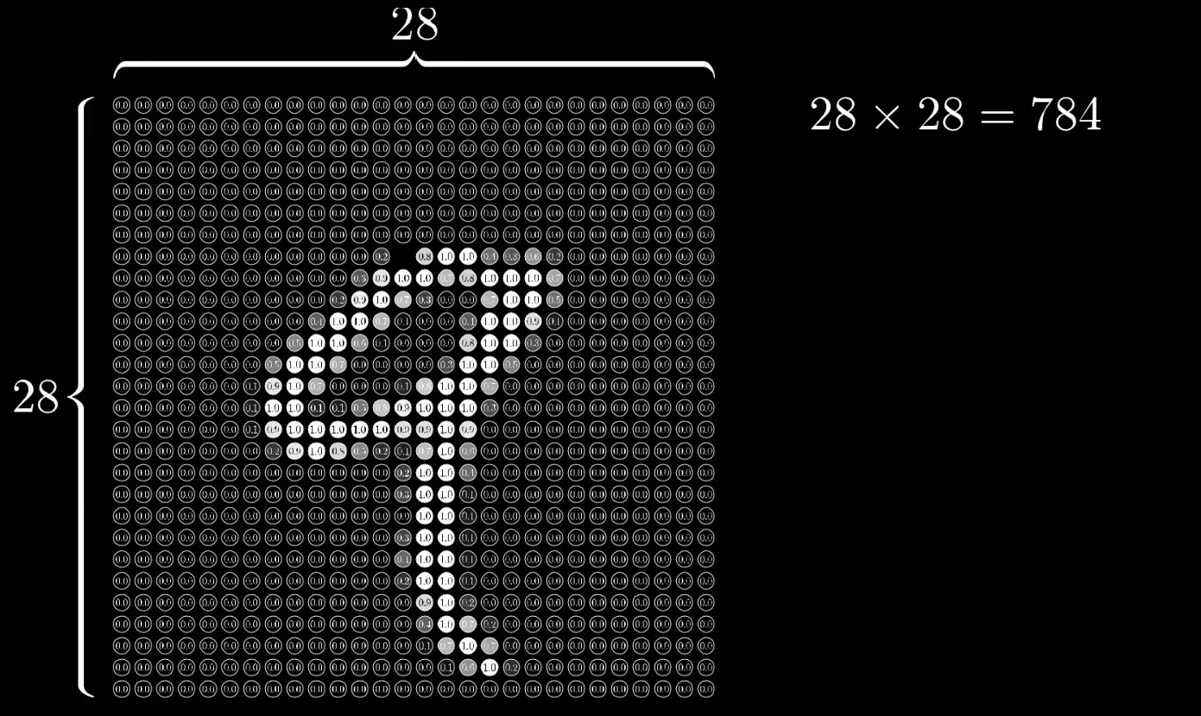
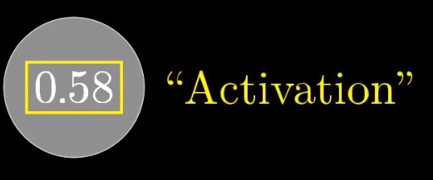
Example Contd…
16 X 16
Output Layer
Input Layer
Hidden Layers

Slide 32
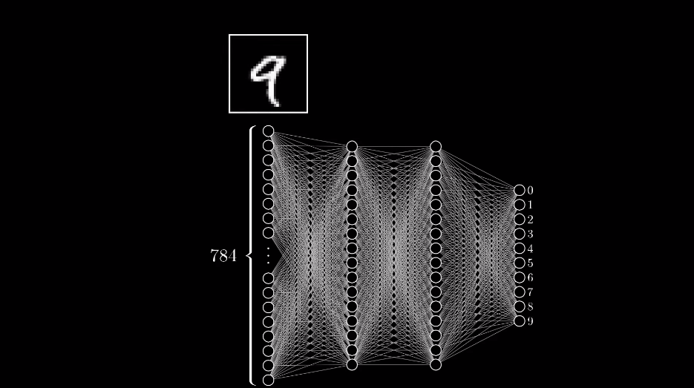

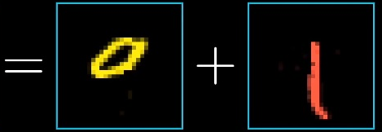

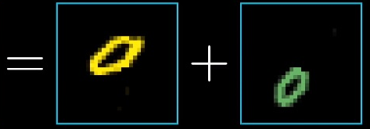

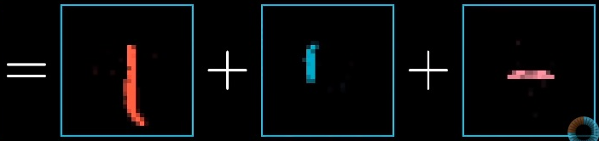
Example Contd…

Slide 33
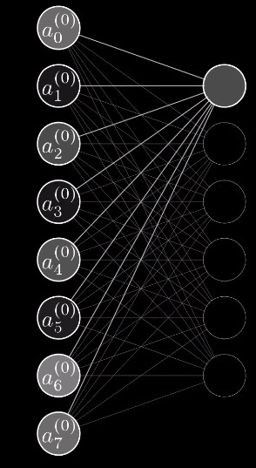
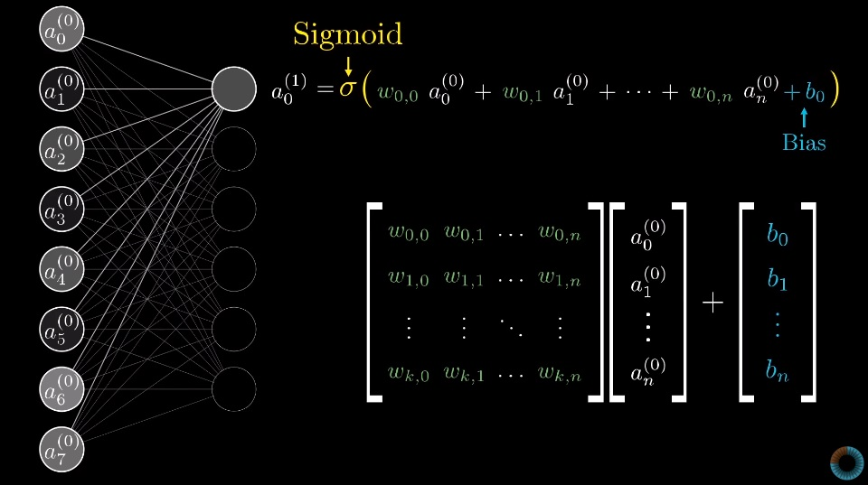
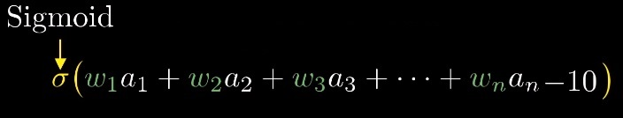
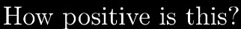
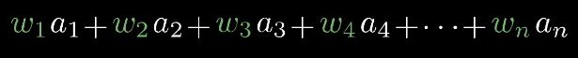
+ b

Slide 34
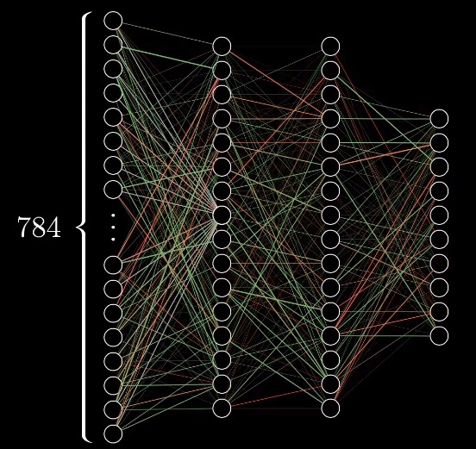
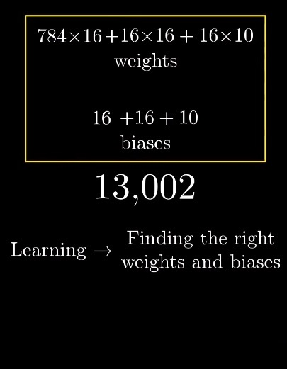

Slide 35
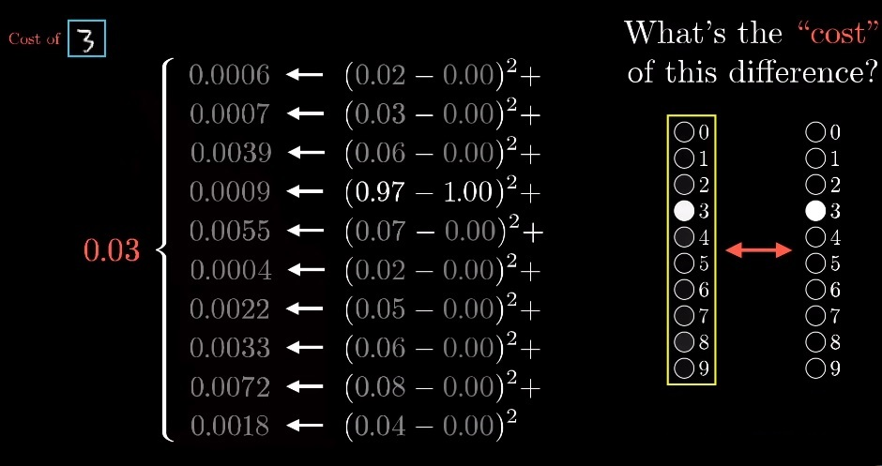
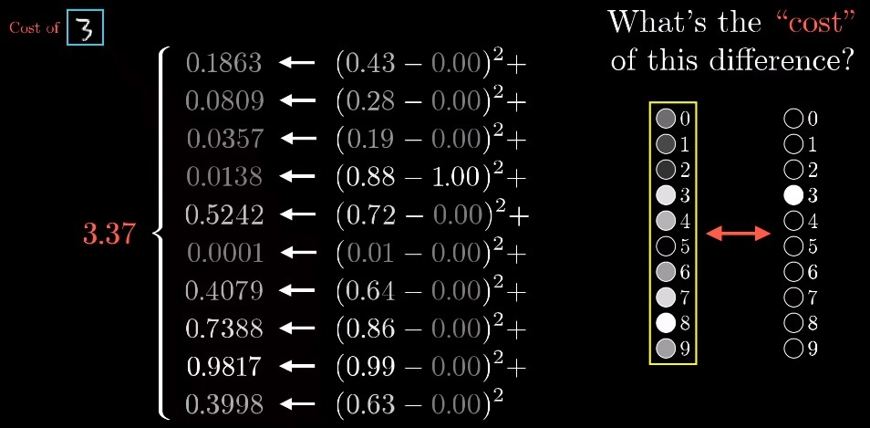
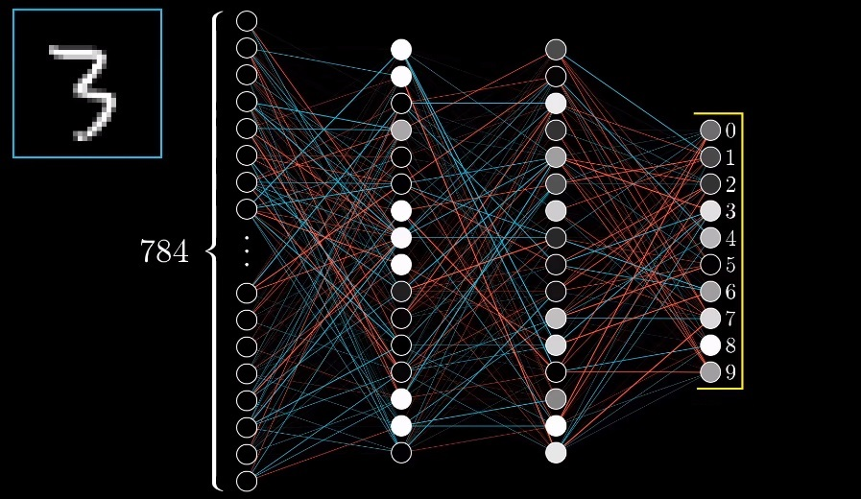
Learning phase
Bad Network
But how to improve it?

Slide 36

Are your neurons still active?

Slide 37
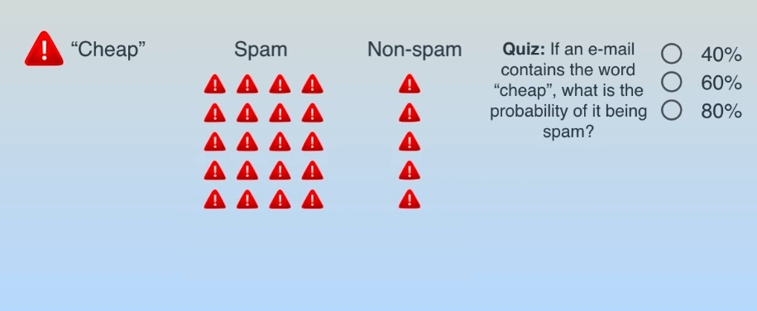
Question

Slide 38
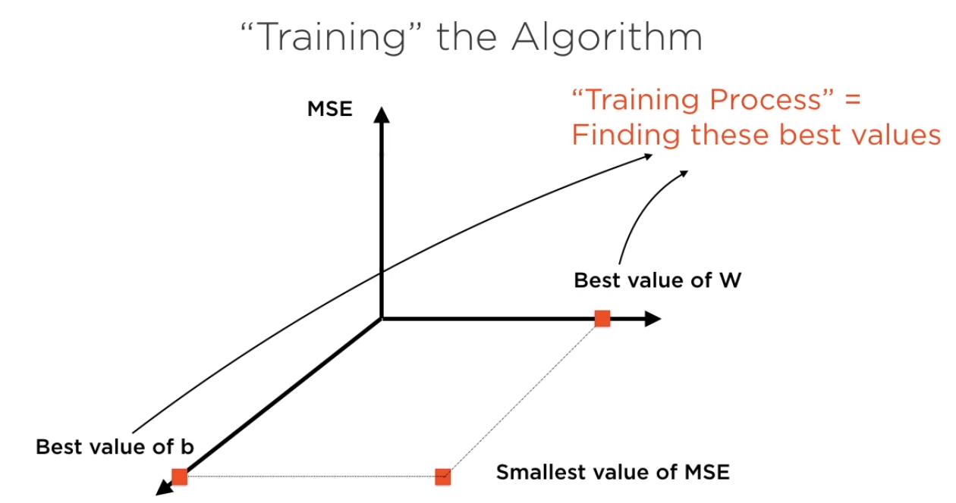
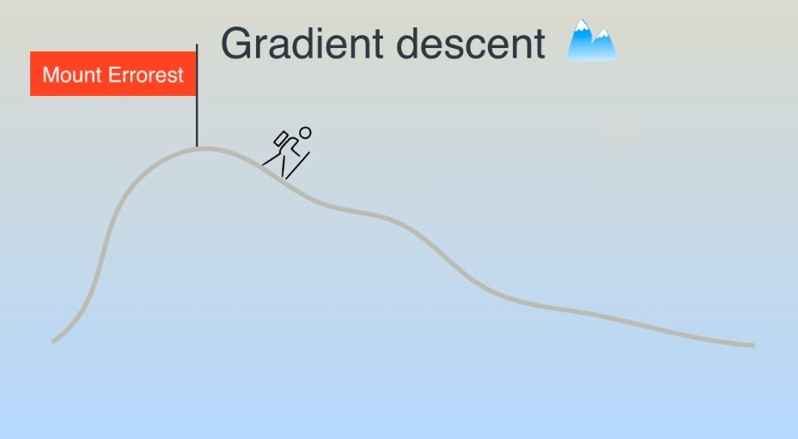
Gradient Descent

Slide 39
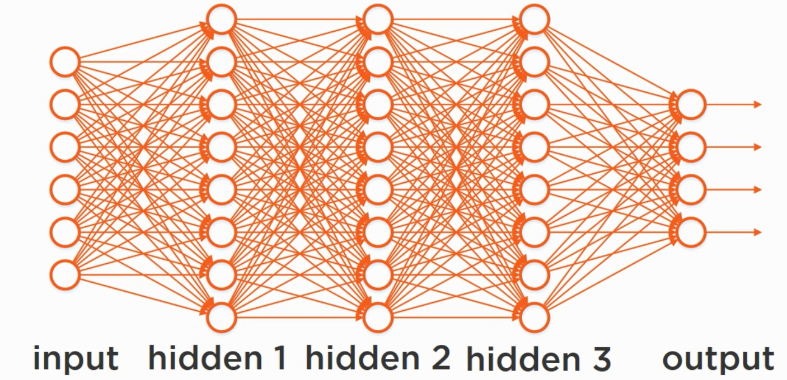
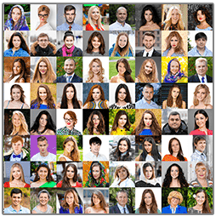
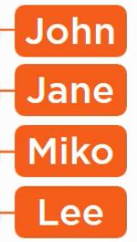



Deep Neural Network

Slide 40

NEURON

Slide 41

Convolutional Neural Network (CNN)
Notes:
The Basic Building block of Convolution layer are Convolution and pooling. A typical Convolutional Neural Network has alternate group of convolutional and pooling layer followed by feed forward layer. Convolutional layers work well with Relu so each layer is followed by Relu. The output of each layer is an image.

Slide 42

Feed Forward Layer
Notes:
The output is then fed to the Feed Forward Layers. Feed Forward layer has the Relu as the as the actibvation Function and Softmax as the output layer. Input is an image and output is probability.

Slide 43

CNN…
Notes:
Convlutional layers extract the low level information’s like pixels. Output of this layer is Feature samples. No of neurons in the second layer depends on the No of strides and size of kernel filter.

Slide 44

CNN…
Notes:
Performs the subsampling of feature and extract the higher layer information like edges and lines. Neurons in this layers doesn’t have a any weight or biases associated.
Why Use Pooling?
Subsampling helps in mitigating the Overfitting data. Greatly reduce the memory usage. Make NN recognize features independent of location.

Slide 45

CNN Filters

Slide 46

Deep Learning Frameworks
Notes:
This are few of the famous deep learning model available in model.

Slide 47



Slide 48


Framework Comparison

Slide 49
Demo
Pytorch Library and Python.
Automobile price prediction and Image Classification.
Neural Network, Neuron, Tensors, Activation Function, Computation Graph,
One Hot Encoding.
Training Neural Network, Forward pass, Backward pass, Gradient descent optimization
Learning rate.
Autograd and Optimizers.
Loss functions ( MSE, Cross Entropy and NLL), Output Layers(SoftMax , LogSoftMax)

Slide 50

PyTorch
Open Source Deep Learning Framework .
More tightly integrated with python than TensorFlow.
Can use python libraries and debugger.
Also supports Dynamic computation graphs, you don’t have to use same neural network .
For each epoch of data set.,can dynamically change the neural network on the fly.
Note : One epoch is when an Entire data set is passed forward and backward through the neural network.
Notes:
PyTorch is an open-source machine learning library for Python, based on Torch.It is primarily developed by Facebook's artificial-intelligence research group,

Slide 51



Tensors
Tensors are just array of numbers.
0-D, 1-D, 2-D, N-D Tensors.
Notes:
Tensors are basically multidimensional array to represent data. This is the central unit of data. Tensor is the data that flows between the computation node of the graph.

Slide 52



Characteristics of a Tensor
Notes:
Rank- Number of dimensions in Tensor
Shape- Number of Element in each dimension.
Data Type – Data type of each element in the Tensor.

Slide 53
One Hot Encoding
Name | Body Type | Fat Percentage
Arvind Dhiman | Athletes | 11
Dhruv Kumar | Obese | 28
Gaurava Sharma | Fitness | 14
Name | BodyType_Athletes | BodyType_Obese | BodyType_Fitness | Fat Percentage
Arvind Dhiman | 1 | 0 | 0 | 11
Dhruv Kumar | 0 | 1 | 0 | 28
Gaurava Sharm | 0 | 0 | 1 | 14
Notes:
We use One Hot Encoding when we have to represent the categorical data in Training Data set. Machine Learning Algorithm works well with the Numeric values.

Slide 54


Computation Graph
Notes:
The neural network that we create using deep learning framework is basically a computation graph. Neurons are called nodes in the Computation Graph.

Slide 55



Operation of a Single Neuron
Notes:
Each neuron applies two simple functions to its inputs. 1- Affine Transformation and 2- Activation Function
Affine Transformation understand the linear relationship between the input and output data..
The output of an Affine Transformation is then fed to the Activation Function.

Slide 56
What is Bias and why do we need it
Each neuron has a bias.
Biases are learnable like weights. We update their values during backward pass using gradient descent.
Biases basically define the threshold of neurons.
Why do we need them?
1
-0.55
-0.35
2
0.1
Notes:
Here we have 2 neurons with weights. Result is -0.35. Let assume we have RELU Activation function so result will be Zero(Max(0,input). This will result in making the third neuron inactive. How to solve this? We can shift the threshold from 0 to -1. Add 1 to weighted sum. This is what bias is used. Give example of Linear Regression now.

Slide 57


Why to add Bias?

Slide 58

What is Bias-Variance Tradeoff?

Slide 59


Slide 60

Common Activation Functions
Notes:
The Main Purpose is to convert a input signal of a node in a A-NN to an output signal. That output signal now is used as a input in the next layer in the stack.

Slide 61
Why do we need Activation Function?
Activation function makes the output function as Non Linear function.
Non Linear function is a polynomial with degree greater than 1. ex- y= square(2x)
Non linear function are powerful for understanding the complex mapping from data and have ability to represent non linear complex arbitrary functional mappings between input and output.
It makes function differentiable which is perform during back propagation for calculating the Gradient.
Notes:
Gradient Descent optimization- we compute the gradient of loss with respect to weights.

Slide 62
Which Activation function to use?
Sigmoid and Tanh is not used now because of gradient vanishing problem.
Gradient vanishing issue creates problem during training and make learning rate slow and degrades the accuracy and performance of Deep Neural Network.
Rectified linear unit(Relu) should only be applied to hidden layer and it doesn’t have vanishing problem.
SoftMax is used in the output layer and is used for classification.

Slide 63
Gradient Descent Optimization
Technique used to find the value of weight and bias with minimal loss.
First we find the Loss= predicted – Actual. Using the derivative of this loss we derive the Gradient.
This calculated gradient is then used to update the model parameters.
Parameter(t+1)= P(t) – Learning Rate * Gradient.
Pytorch uses the Autograd library for Backward Propagation and computes the Gradient automatically.
Using the Gradient you can update the Model parameter manually or use the optimizers.
Notes:
Learning rate determines how bigger step you want to take in direction of decreasing gradient. We compute the gradient for each model parameter.
AutoGrad relies on reverse mode automatic differentiation to compute gradient.
Autograd remembers track the all model parameters. In forward pass we need to turn it off.

Slide 64


Forward Pass

Slide 65

Backward Pass

Slide 66

Optimizers
Notes:
In our Example we have used Adam optimizer.
Where we first compute the momentum vector using gradient and then use this to compute the model parameter.
Momentum_Vector= momentum_coeff + learningrate*gradient.
Paramter(t+1) = Parameter(t)-Momentum_vector

Slide 67
Thank
You!!!
All

